Slide 1

Enabling the Transition from document to data with Scalable Digital Trust
For discussion only
2 October 2023

Slide 2


What are we creating
ICC DSI and the Digital Governance Council (DGC) of Canada are collaborating to develop a Conformity Assessment program for systems and services that enable the electronic exchange, management, and interoperation of trade documentation in digital forms.
The scheme is being developed within the DGC’s Digital Trust Conformity Assessment program which brings together standards, assessment methodologies, accreditation programs and communities to engender digital trust that is principles-driven, evidence-based and open-source by design.

Slide 3
Evolution of Trade Documentation
From Paper through to Verifiable Data Elements
[0] Exchange of Physical Paper
[1] paper substitutes - PDF via mail, PDF on registries, central, pseudo-decentralised DLT purporting authenticity
[2] structured data aggregates - documentation as key value pairs
[3] authentic structured data aggregates - documentation as key-value-pairs attributable to the aggregate originator.
[4] authentic structured data aggregates consisting of authentic data elements - every element of the aggregate can be verifiably traced back to its originator.

Slide 4
What have we done so far
Idea
Market Research
CAS Definition
CAS Elaboration
Test / Focus Group
Formalizing the CAS
Certification
June
July
August
September
October -November
December
Kick off of Certification Working Group under the DSI Indusry Advisory Board
Members include:
ISO
British Standards Inst
SGS
Inditex
Singapore Standards
Swift
Elevate/LRQA
DSCI / Ethisphere
C4DTI / ICCUK
Supply chain certifications landscape: what else is out there?
Potential users – buyers, suppliers, shippers, financial institutions. What do they want? What do they need?
Auditors and Assessors: qualifications and operating models
Maturity Model: self assessment, baseline, what does Gold look like
Conformity assessment scheme brief scope
Technical needs analysis
Elaborate technical requirements for scheme pillars
Test with focus groups including certification working group, assurance companies, digital platforms and others
Establish pilot pathways with UK and Germany ETDA implementation
Development of the Scheme
Explore other ways to bring CAS to market (e.g. other standards bodies)
Focus groups
Business Plan
ISO pathway
Release

Slide 5
What we would like to achieve today
1. Introduce principles and references for the assessment of systems ad services in four basic pillars (on next page)
Have we segmented the issues correctly?
Are the standards and legal references correct?
Are there any assessment criteria which are over or underscoped?
2. Gather any relevant references (standards, laws, certifications) needed to develop the scheme.
3. Identify any experts who might be able to contribute to the scheme.

Slide 6
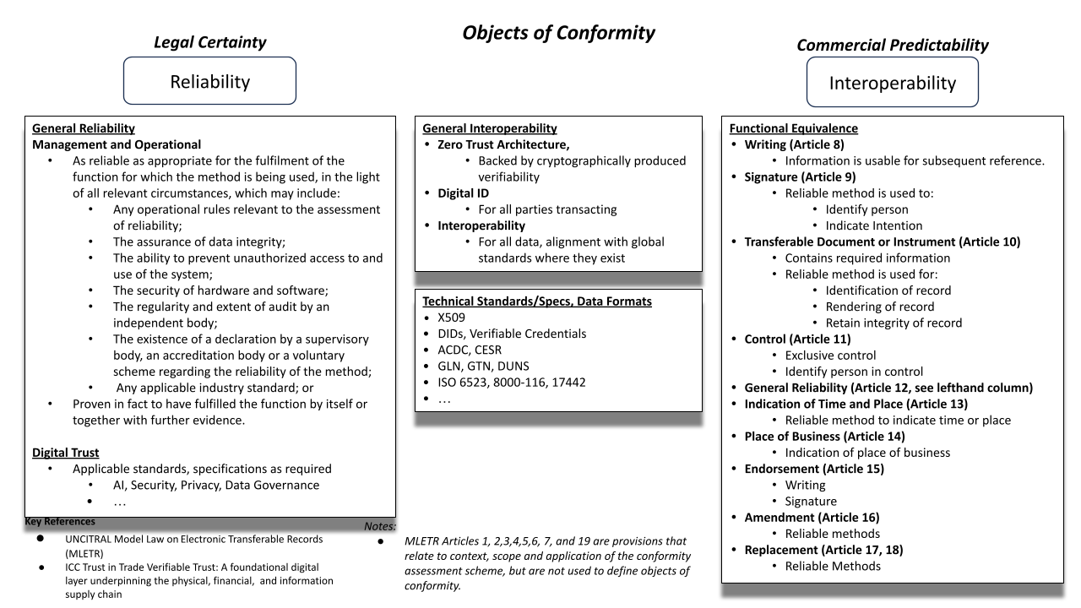

Slide 7

Digital transformation is a team sports
Educate and engage your community
Digital transformation
Supply chain digitalization
Digital standards adoption
Advocate to your governments
Adoption of global standards
Paperless trade and trade facilitation implementation
Alignment with global legal frameworks
Subscribe to our news
Visit www.dsi.iccwbo.org

